Slide 1


Recommendation System​​
A recommendation system (or recommender system) is a class of machine learning that uses data to help predict, narrow down, and find what people are looking for among an exponentially growing number of options.
In simple words, it is an algorithm that suggests relevant items to users. Eg: In the case of Netflix which movie to watch, In the case of e-commerce which product to buy, or In the case of kindle which book to read, etc.
by Sonu Sarojini

Slide 2

Understanding the Fundamentals of Recommendation Systems
1
User Preferences
2
Item Features
3
Algorithms
Recommendation systems start by understanding user preferences, whether explicit (ratings, reviews) or implicit (browsing history, purchase data). This information is critical for generating tailored recommendations.
This involves analyzing attributes like genre, content, and user engagement data to accurately match items to users.
Recommendation systems employ diverse algorithms like collaborative filtering, content-based filtering, and hybrid approaches to generate relevant suggestions.

Slide 3
Types of Recommendation Systems
Content-Based Filtering
Collaborative Filtering
Hybrid Approach
This approach recommends items similar to those a user has interacted with in the past. It analyzes the content of items and user preferences based on those attributes.
This method leverages user similarity. It recommends items based on the preferences of other users who share similar tastes, even if they haven't interacted with the same items before.
A combination of content-based and collaborative filtering, this method leverages strengths from both to provide more robust and personalized recommendations.
Eg: if a user enjoys action movies, the system will suggest other action films based on their characteristics, such as genre, director, or cast.
Eg: If many users who liked "The Dark Knight" also enjoyed "Inception," then the system might recommend "Inception" to someone who enjoyed "The Dark Knight," assuming they have similar tastes based on their ratings of other films.
Eg:A music streaming service uses content-based filtering to recommend tracks similar to those you’ve previously enjoyed based on attributes like genre, artist, and tempo. Simultaneously, it employs collaborative filtering by analyzing users with similar listening habits.

Slide 4
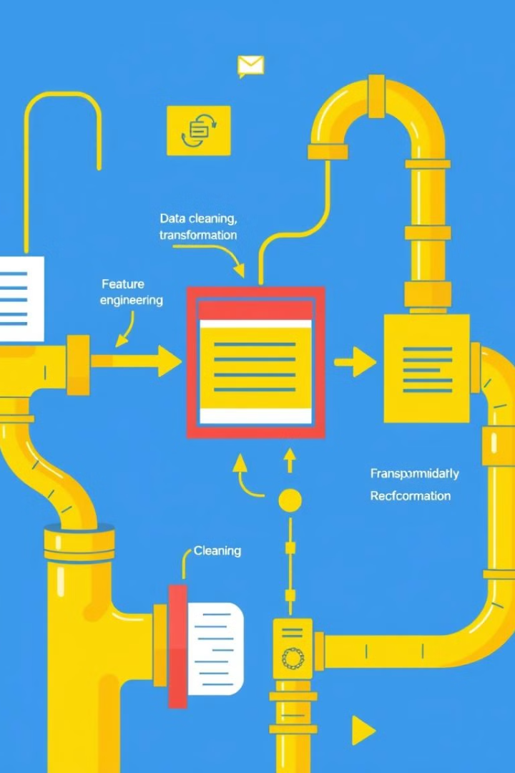
Data Preprocessing and Feature Engineering for Recommendation Systems
1
Data Collection
This step involves gathering user interaction data, item features, and contextual information relevant to the recommendation system.
2
Data Cleaning
Handling missing values, removing duplicates, and addressing inconsistencies ensure data quality for accurate analysis and model training.
3
Feature Engineering
This involves creating new features from existing data, such as user demographics or item popularity, to provide richer insights for the recommendation engine.
4
Data Transformation
Transforming data into a suitable format for modeling, such as normalization or standardization, ensures efficient and accurate model performance.

Slide 5

Example: Music Recommendation System (YouTube Music)
CASE STUDY
System Overview:
YouTube Music uses smart technology to suggest songs you might like. It looks at what you've listened to before, the kind of music you like, and what other people with similar tastes are listening to. It's like having a personal music assistant that knows your preferences and recommends songs that you'll enjoy.

Slide 6
TECHNIQUES USED
1.Collaborative Filtering
User-Based: This method identifies users with similar listening habits and recommends music that those users have enjoyed.
Item-Based: This approach recommends songs that are similar to those a user has already listened to, based on their audio features, genre, and artist.
2.Content-Based Filtering
This technique analyzes the audio features of songs, such as tempo, rhythm, and harmonic structure, to recommend similar tracks.
It also considers metadata like genre, artist, and lyrics to find relevant recommendations.
3.Hybrid Approach:
YouTube Music likely combines collaborative and content-based filtering to create a more robust and accurate recommendation system.
This hybrid approach allows for a more nuanced understanding of user preferences and content similarities.
​​

Slide 7
Machine Learning:
Matrix Factorization: This technique decomposes large user-item matrices into smaller matrices, enabling efficient similarity calculations and recommendation generation.
Neural Networks: Deep learning models can capture intricate relationships between users, songs, and contextual factors, leading to more accurate and personalized recommendations.
Natural Language Processing (NLP):
NLP techniques can analyze lyrics and reviews to understand semantic meaning and sentiment, helping to identify songs that align with a user's musical tastes.
Audio Fingerprinting:
This technology identifies songs based on their unique acoustic signatures, allowing for accurate recommendations even when metadata is missing or inaccurate.

Slide 8
The Role of User Behavior and Contextual Factors
YouTube Music's recommendation system also considers various contextual factors to enhance the personalization of recommendations:
Listening History: The system analyzes a user's past listening behavior to identify their preferences.
Playlists: The creation and curation of playlists provide valuable insights into a user's musical tastes.
Likes and Dislikes: Explicit feedback from users helps the system refine its recommendations.
Search Queries: User search queries reveal specific interests and preferences.
Time of Day and Location: The system can adapt recommendations based on the user's current context.

Slide 9
Impact of the Recommendation System
YouTube Music's recommendation system has had a profound impact on the platform's success:
Increased User Engagement: Personalized recommendations keep users engaged by consistently delivering relevant content.
Enhanced User Experience: By understanding user preferences, the system provides a seamless and tailored listening experience.
Music Discovery: The system helps users discover new artists and genres, expanding their musical horizons.
Revenue Generation: Effective recommendations drive user retention and premium subscriptions, contributing to YouTube Music's revenue growth.

Slide 10
Challenges and Future Directions
While YouTube Music's recommendation system is highly effective, it still faces challenges:
Cold Start Problem: Recommending music to new users with limited listening history.
Serendipity: Balancing personalized recommendations with discovering new and unexpected music.
Contextual Awareness: Adapting recommendations to real-time user context (e.g., mood, activity).
Ethical Considerations: Ensuring fairness and diversity in recommendations, avoiding biases and filter bubbles.
To address these challenges, YouTube Music may explore further advancements in machine learning, natural language processing, and audio analysis techniques.

Slide 11
Conclusion
YouTube Music is a great example of how technology can personalize our experiences. It uses clever algorithms to understand our music tastes and suggest songs we might like. This makes listening to music more enjoyable and helps us discover new artists. As technology improves, YouTube Music will get even better at recommending music tailored to our individual preferences.

